Slide 1
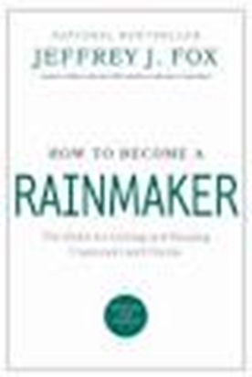
Fox offers many pieces of valuable advice, but we’re going to focus on seven that will improve your sales performance. Here’s what you should know:

Slide 2
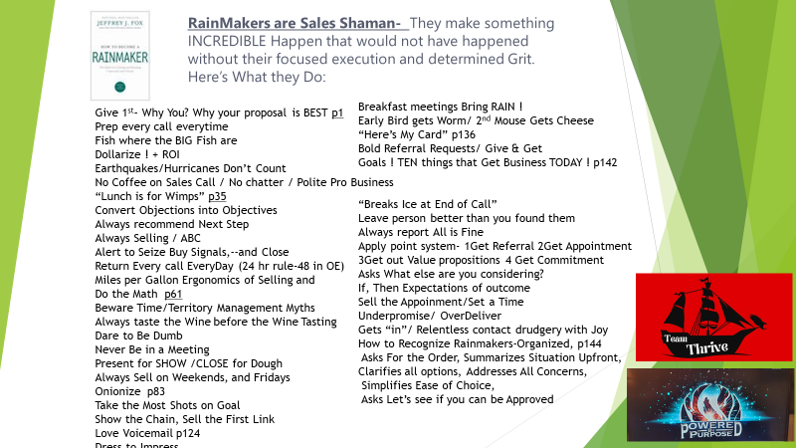

Slide 3

1. Improve Sales Performance with the “Rainmaker’s Credo.”
It’d hard to leave the Rainmaker’s Credo off this list. It’s the Ten Commandments of sales, although it’s more like a dozen or so. All great mantras that anyone should keep in mind to improve sales performance, Fox includes each of these credos because they’re his ultimate sales KPIs.
Cherish customers at all times.
Treat customers as you would your best friend.
Listen to customers and decipher their needs.
Make (or give) customers what they need.
Price your product to its dollarized value. (Dollarizing is the act of assessing the differences between competitive products and calculating the financial impact those differences have on your customer.)
Show customers the dollarized value of what they will get.
Teach customers to want what they need.
Make your product the way customers want it.
Get your product to your customers when they want it.
Give your customers a little extra — more than they expect.
Remind customers of the dollarized value they received.
Thank each customer sincerely and often.
Help customers pay you, so they won’t be embarrassed and go elsewhere.
Ask to do it again.

Slide 4
2. Always answer: “Why should this customer do business with us?”
There are many things your salespeople should ask buyers to diagnose their needs but the question of all questions is why a customer should be doing business with your business. This question addresses points like what value you offer over competitors and why the customer will benefit from your services.
Fox believes this one’s central to optimal sales performance, because with the answers on hand, well, you have all the answers you need.
3. Treat each customer as you would treat yourself.
A great lesson for sales and life in general, this approach toward your buyer is something that can truly be detected through the sales process. Fox urges you to “deliver on your promise.” Putting yourself in your customers’ shoes ultimately helps you understand them better, boosting your sales performance because you deliver better service.
Start thinking about this as you interact with buyers. That’s how the rainmaker makes rain. Then when you’re ready to treat them like yourself, bring your umbrella with you. Starting to sound like Fox, aren’t I?

Slide 5
4. Build a pre-call plan for every sales call.
Much like the Rainmaker’s Credo, the pre-call plan is a list of sacred actions that should take place prior to making a sales call:
Written sales call objective – Write out what your objective(s) for this call are.
Analysis questions – Ask questions that allow you to further analyze the situation (for example, how many employees does the prospect’s company currently have?).
Something to show – Maybe it’s an offer. Maybe it’s a new product. Don’t show up empty-handed.
Anticipated buyer concerns and objections – Always be one step ahead and come prepared with reassuring solutions to the concerns you expect.
Points of difference vis-à-vis competitors – Know your competition. Present your differences in a factual manner that does not diminish your competitor’s product.
Meaningful buyer benefits – Benefits are all businesses care about. Don’t forget.
Dollarizing buyer benefits – Calculate a dollar amount that could be saved or earned with your product over their current situation.
Strategies to handle objections and eliminate buyer concerns – Have clear plans in place that will quell any concerns.
Closing strategies – Plan a closing phrase that will take the conversation to next steps.
Expected surprises – Don’t be caught off guard. Know how to handle surprises. If you don’t have an immediate answer when on a call, let the buyer know that you are working on one.
These tasks prepare you for several situations before you even pick up the phone.

Slide 6
5. Always dollarize the benefits of your product.
Too often, we don’t help the buyer understand exactly how our product would help their business, especially in dollars. This is what really matters at the end of the day, isn’t it?
Rainmakers dollarize by pairing the buyer’s ROI with their own product and also dollarizing the financial consequence of passing up on their product. Genius. How didn’t I think of that?

